Slide 1
Lewis Structures
Can you draw the lewis structures for the following compounds?

Slide 2
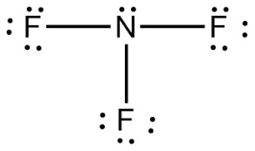
Question 1
Draw the Lewis Structure for:
NF₃
Answer the following question:
How many unshared pairs are on the central atom?
1

Slide 3
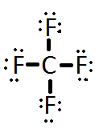
Question 2
How many valence electrons are in:
CF₄
32
Draw the Lewis structure for the compound above.

Slide 4
Question 3
How many valence electrons are in:
H₂Se
8
Draw the Lewis structure for the compound above.

Slide 5
Question 4
Draw the Lewis Structure for:
NH₃
Answer the following question:
How many atoms are bonded to the central atom?
3

Slide 6
Question 5
Draw the Lewis Structure for:
OF₂
Answer the following question:
How many unshared pairs are on the central atom?
2

Slide 7
Question 6
How many valence electrons are in:
HCN
10
Draw the Lewis structure for the compound above.

Slide 8
Question 7
Draw the Lewis Structure for:
O₃
Answer the following question:
How many unshared pairs are on the central atom?
1

Slide 9
Question 8
Draw the Lewis Structure for:
CS₂
Answer the following question:
How many atoms are bonded to the central atom?
2

Slide 10
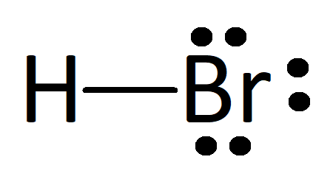
Question 9
How many valence electrons are in:
HBr
8
Draw the Lewis structure for the compound above.

Slide 11
Question 10
Draw the Lewis Structure for:
ICN
Answer the following question:
How many atoms are bonded to the central atom?
2

